Slide 1





Mathpreneurship in Purchasing and Supply Chain World
Introduction
Purchasing and Supply Chain
Type of
Organisazation
Video Related to Supply Chain
Efficiency
Procurement Function
Welcome!!

Slide 2

+10 years working experiences in Procurement.
Equipped with extensive experience in FMCG companies.
Experienced in managing Global/ Local Supplier relationship for South East Asia Region.
Expertise in Logistics Procurement, Indirect Spend areas, and good experience in dealing with different cultures globally.
2002- 2006
2006- 2007
2007- 2012
2012- 2018
2018- present
4 Years
1 Years
4.5 Years
6 Years
FMIPA Unand
Prognosys E Service
BT Logi Trans
Kraft Foods
Unilever
Procurement Logistics– South East Asia Australia & New Zealand
Asia Pulp and Paper SinarMas
Mathematics 2002
Local Committee President AIESEC Indonesia
2005-2-006
Jakarta
New Delhi India
Research Analyst
Operation Logistics
Procurement buyer
RM, PM, Logistics
Logistics Domestics Transport
All Business Unit

Slide 3
Introduction Modul
Video Supply chain Coca Cola
Video Supply Chain Iphone
Video Supply Chain Unilever
Video Supply chain Asia Pulp and Paper

Slide 4
Coverage: The Total Supply Chain

Slide 5
Purchasing
Forecasting demand & planning production
$
Managing inventory
Purchasing & supply
chain management
Trans-portation
Customer service
Storage, handling & packaging
M1:U1:1.1-3

Slide 6
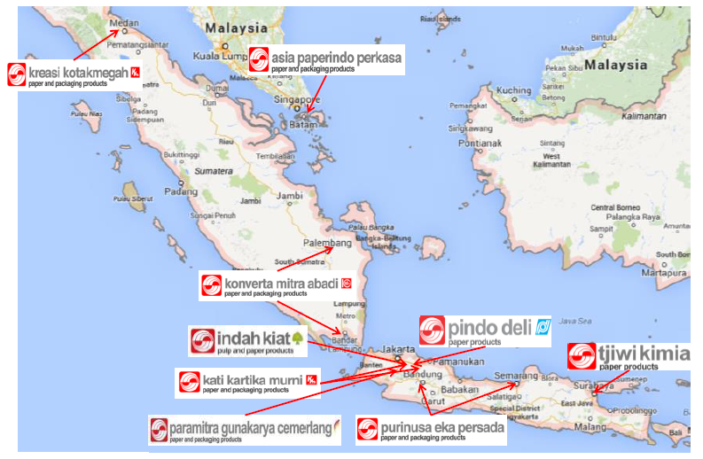
Sample of network and Supply chain flow
Carton Box
Note: 3 plants in IKS
Strategic Locations
15 locations
TOTAL numbers of APP carton box mills

Slide 7








Carton Box
Main Product
Carton Sheet
Carton Box
Single Wall
Top Bottom Box
Flap Box
Double Wall
Single Face
A1 Box
Die Cut Box

Slide 8
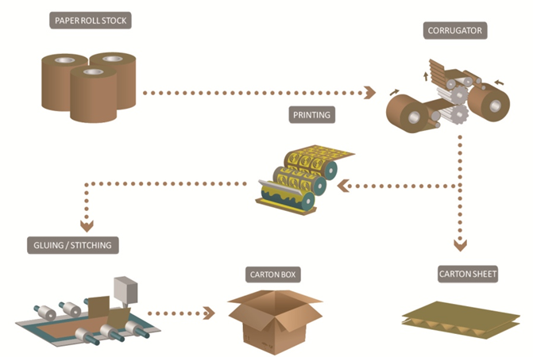
Carton Box
Converting Process

Slide 9
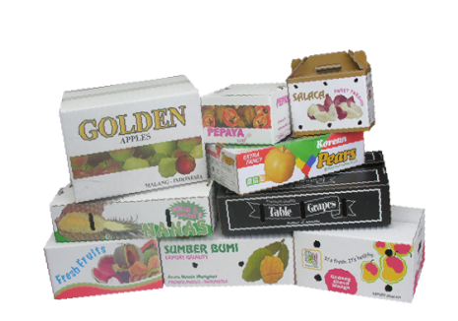

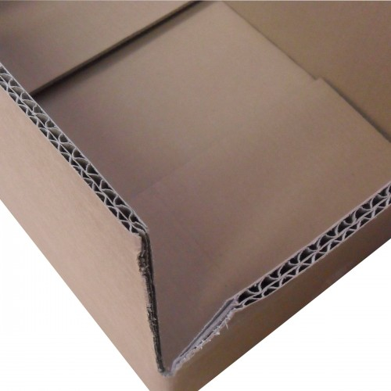
Carton Box
End Application
Outer Box with
White-Top-Liner
Outer Box with
High-Strength Liner
Outer Box with
Value-Grade Liner
SPECIAL FOR PREMIUM-LOOK PURPOSES
- Excellent Printability
- Smoother Surface
SPECIAL FOR HEAVY-DUTY PURPOSES
- High strength
- Very Good Printability
COST-COMPETITIVE
Enough strength
Very Good Printability

Slide 10
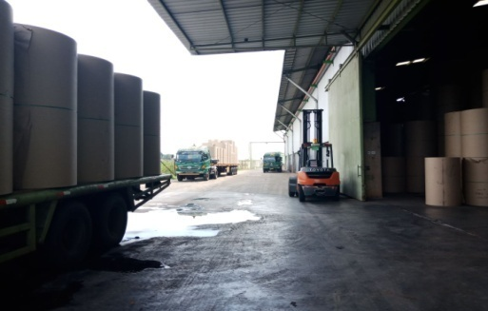
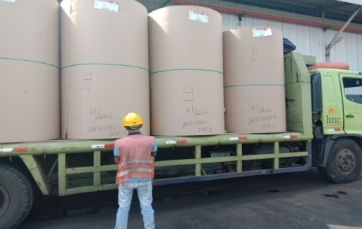
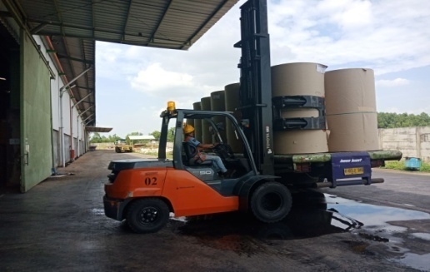
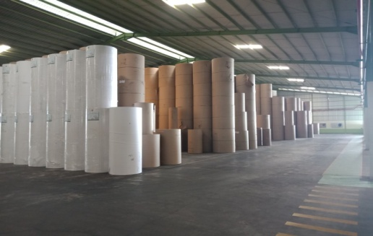
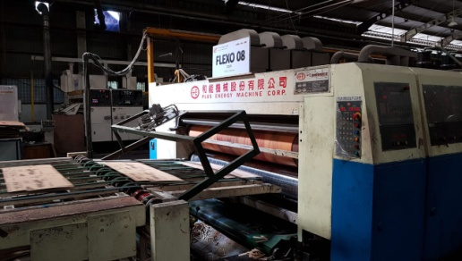
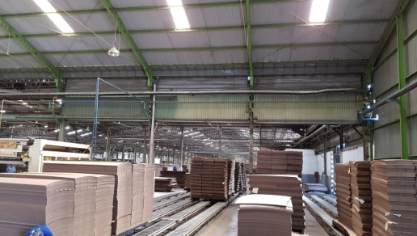
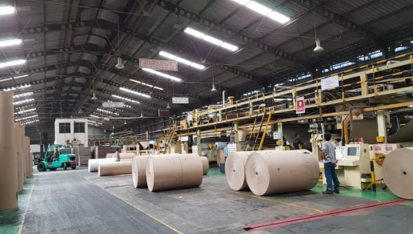
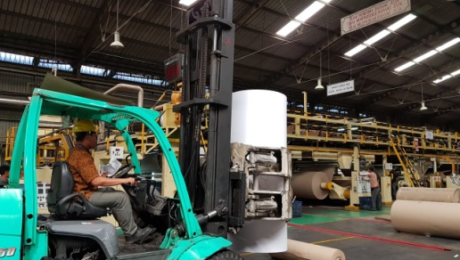
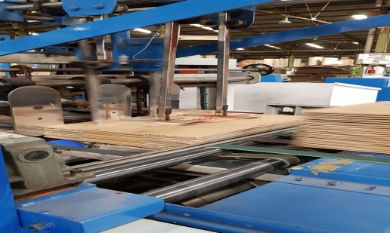
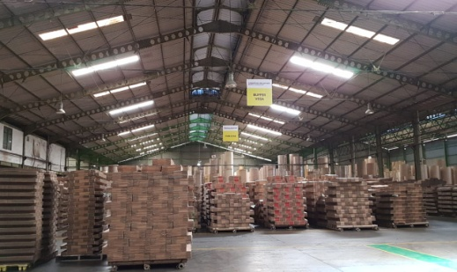
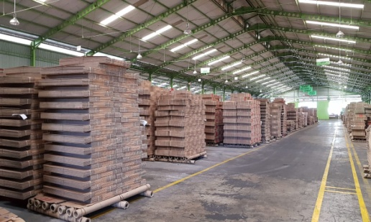
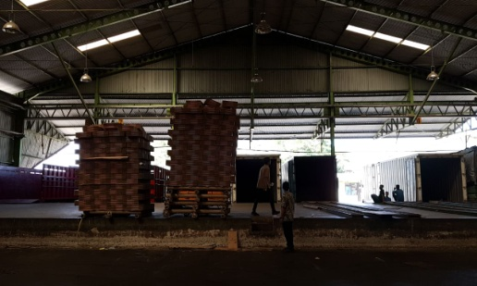
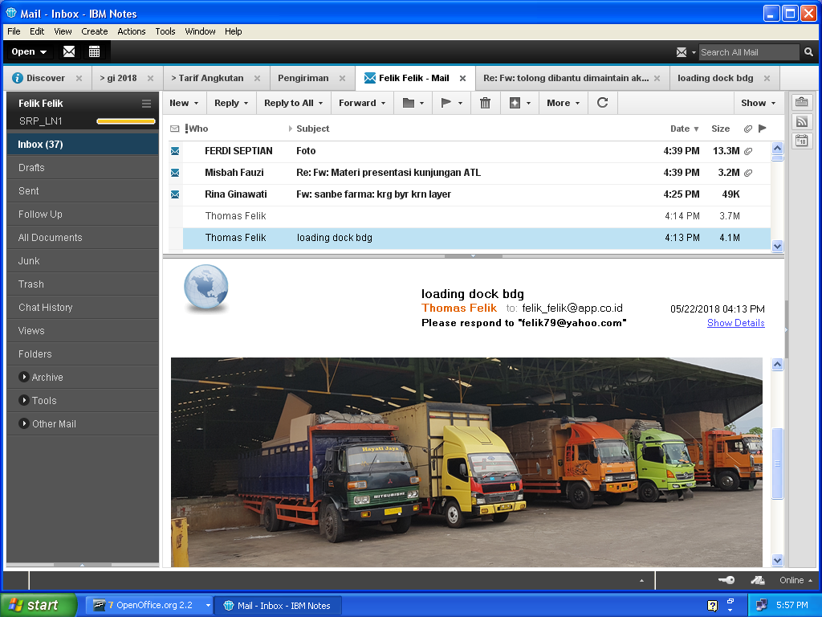
Flow Process
Truck Queuing
Ready to Unload
Unloading Process
Storage Paper Roll
Flexo Process
Sorting Process
Corrugator Process
Paper Roll to Corr.
Finishing Process
FG at Production Area
FG at Warehouse Area
Loading Dock
Sheet
Delivery Process

Slide 11
Purchasing & supply involves all of those management processes and operations needed to ensure that an organisation is able to obtain cost-effectively from outside sources all of the products and services that it requires. This is key to managing a firm’s integration into the supply chain.
Porter’s value chain within the enterprise
PRIMARY VALUE-ADDING ACTIVITIES
Inbound
Logistics
Production
Outbound
Logistics
Marketing
& Sales
Service
IT systems
Margin
Human resources management & training
SUPPORT
ACTIVITIES
Research & development
Purchasing & contracting
Finance, planning, etc.

Slide 12

P&S in different types of organisations
Non-profit
organisations
Public sector
Private
organisations
enterprises
The size of sectors varies depending on the economic system (e.g., free market vs. centrally planned economy).
The P&S function varies depending on the sector.
M1:U2:2.2-1

Slide 13
1. Private enterprises:
The importance of SMEs...
SME
represent more than half of GDP and half of employment worldwide
=
M1:U2:2.2-2

Slide 14

1. Private enterprises:
Advantages of SMEs
Low overhead
costs
Quick reactions
Close supervision
& control
Reduced taxes,
special credit

Slide 15
1. Private enterprises:
Disadvantages of SMEs
Depend on
their leaders
Vulnerable due to
limited product
range
SME
BANK
Lack skilled staff
& information
systems
$
Have difficulties
in raising
capital

Slide 16
1. Private enterprises:
Constraints of P&S in SMEs
Shortage of
working capital influences
size & timing of orders
SME
P&S function
not well
developed
No IT support
No specialised
P&S staff
Limited P&S knowledge
and skills
M1:U2:2.2-5

Slide 17
Importance of purchased material costs
in the total cost structure of selected SMEs in Asia
Pakistan
India
Indonesia
Bangladesh
20%
40%
60%
80%
Rubber processing
Food processing
M1:U2:2.2-6

Slide 18
1. Private enterprises:
Advantages of Multinationals
More diversified
& synergies
Many customers
& well known
Greater access
to finance
Qualified staff
Information
systems

Slide 19
1. Private enterprises:
P&S in Multinationals
Leverage due to
high volumes &
reputation
P&S strategies
& policies
Optimal order
quantities
IT support
systems
Well developed
P&S function
Specialist P&S
staff

Slide 20
1. Private enterprises: Large local enterprises
SME
Advantages & disadvantages: in between SMEs and multinationals
Likely to have a purchasing function

Slide 21

2. Public organisations: Public sector services
Health services
Road construction
Education
LAW
Law & Order
Emergency services

Slide 22
2. Public organisations: levels & types
Autonomous or semi-autonomous public sector bodies
Central government ministries and departments
(postal service, utilities, public enterprises...)
Decentralised provincial and municipal governments

Slide 23
2. Public organisations:
The public sector difference and P&S
Private companies are driven by profit, whereas public organisations are driven by accountability to the public
Increasing pressure to ensure “better governance” =
Value for money
Work is conducted ethically
Decisions based on clear and objective criteria
All parties treated fairly, and have equal access

Slide 24
2. Public organisations: Public procurement
The World Trade Organisation’s
Government Procurement Agreement aims at opening the public sector to competition
Public procurement rules often force buyers to act in a certain way
Complying with highly prescriptive procedures can cause delays and higher costs,
= conflict with efficiency and good value for money.
Government
procurement
procedures can
be lengthy and bureaucratic!

Slide 25
3. P&S in non-profit organisations
E.g.:
Foundations
Co-operatives
Professional associations
Non-profit
Academic institutions, etc.
organisations
Funding from members or sponsors
Grants
Income from fees for services
P&S essentially as in the private sector but may be required to follow guidelines of major sponsors or donors, etc.

Slide 26



Sectors of the economy
The secondary sector:
Conversion and processing of raw materials into finished goods (manufacturing),
Electricity & water utilities and construction.
The primary sector:
Extraction of raw materials: drilling, mining, quarrying...
Fishing, forestry, agriculture…
The tertiary sector:
banking, logistics, consultancy and retailing.

Slide 27
P&S in different sectors
Primary sector
Secondary sector
Tertiary (services) sector
Purchase of maintenance, repair and operation (MRO) items
Supply of components and materials to the production line
Importers, wholesalers, retail = P&S critical
Purchasing and supply function fundamentally important to most manufacturing firms
Large size of certain plant and machinery
Banking, logistics, repair & maintenance, communications, tourism & travel, consultancy….. = importance of P&S varies
Highly specialized
Focus = continuity of supply
Operational supplies
Capital equipment for utilities...
P&S is also affected by the rate of change in market conditions and in technological developments
M1:U2:2.3-3

Slide 28
Ultimate objectives
of all buying organisations...
♦
obtain the required goods...
♦
delivered on time...
♦
in the right quantity...
♦
at the right place...
♦
and in the most cost-effective way.
M1:U2:2.3-4

Slide 29
Step to run the new product market

Slide 30
The strategy-setting
The strategy-setting
process
process
2. Analyse the firm’s
competences & its
product/service offer
1. Review the market
3. Generate product-
and business
market options
environment
6. Prioritise
4. Analyse options
5. Compare & select
options
M1:U4:4.2-1

Slide 31

Short- and long-term strategy actions
Short-term strategy actions generally aim to develop sales of a particular product/service over the next 2-3 years
12
9
3
6
12
9
3
6
Long-term strategy actions generally
aim to build up a company’s competences and
thus enhance its long-term competitive advantage
M1:U4:4.6-6

Slide 32

Action Point
4.6-1
Determining the offers required to develop a product-market option
M1:U4:4.6-7

Slide 33
Reviewing sales targets
Get more in-depth information on market potential, opportunities and risks
More defined sales targets

Slide 34
Setting target offers
Figure 4.6-2
in order to achieve expected sales
Product/service:
Computer sets
Market:
Padang
3 years’ sales prospects:
$
1,200,000
Product/service features &
Our current
Target offer
conditions
offer/capabilities
Functionality: output in Watts
10 W
12 W
Performance reliability (No. of
sets returned by customers, for
2 per thousand
1 per thousand
every 1,000 sets sold)
Lead-time to delivery (orders of
30 days
18 days
1,000 units)
Price/cost per unit
$ 50 (cost of $ 44)
$ 46 (cost of $ 40)

Slide 35
Action Point
2.4-1
About your organisation
Private
Non-profit
Public
SECTORS
Primary:
Extractive
Secondary:
Manufacturing
Tertiary:
Services

Slide 36
Examples of supply objectives associated with required product/service offers
Figure 5.3-3
Area of required product/service offer
Examples of possible supply objectives

Slide 37


Better Supply Chain Management helps a firm to...
Ensure continuity of production
Reduce total costs
Improve quality
Respond quickly to market changes
12
Innovate
9
3
6

Slide 38
Procurement function

Slide 39
Determining and specifying requirements means knowing:
What is required?
How much is required?
When is it required?
Where should it be delivered?
How should it be transported?
How should it be quality tested?
What other information does my supplier need?

Slide 40

Not specifying your products or services correctly may lead to:
Interruptions in the production process
Damaged and unusable inputs
Using prohibited substances
Machinery and equipment breakdowns
Services not available when needed

Slide 41
Types of requirements
Operational requirements (needed to run day-to-day business)
Capital requirements
Production requirements (directly related to producing the goods or services)
Non-production requirements
M2:U2:2.2-1

Slide 42
The purchasing & supply process..
...is a group of related activities
it consists of:
Processes
Sub-processes
Focus
= the end
Customer
Intermediary outputs
it is about:
Producing optimum value with a minimum use of time, effort and resources

Slide 43
People resources
Types of skills, knowledge and personal attributes
often required of purchasing & supply staff
Good understanding and practice of purchasing & supply strategy, management methods and techniques.
Good understanding of the business of the enterprise
People management and leadership skills.
Capacity for analysis, innovation and creativity.
Persuasion and negotiation skills.
Good communication abilities.
Good technical knowledge of the products and services purchased
Knowledge of English and other foreign languages
Knowledge of contracting and commercial law.
Knowledge of costing and value analysis techniques.
Knowledge of all relevant operational areas of the supply chain
Also need to be:
Service and client-orientated, creative problem-solvers, well organised, efficient continuous training of staff is critical

